Slide 1
Assessing Treatment Effects in Observational Data with Missing Confounders: A Comparative Study of Practical Doubly-Robust and Traditional Missing Data Methods
CI4: Subset Calibration Methods
Pamela Shaw, PhD, MS
Kaiser Permanente Washington Health Research Institute
Seattle, WA
September 10, 2024

Slide 2
Disclaimer
This work was supported by Task Order 75F40122F19010 under Master Agreement 75F40119D10037 from the U.S. Food and Drug Administration (FDA).
The views expressed in this presentation represent those of the presenter and do not necessarily represent the official views of the U.S. FDA.

Slide 3
Acknowledgements
This work is being done by the Sentinel CI4 Subset Calibration Working Group:
Brigham and Women’s
Hospital/Harvard Medical School
Rishi Desai
Richard Wyss
Kaiser Permanente Washington Health Research Institute
Eric Johnson
Chloe Krakauer
Jen Nelson
Pamela Shaw (PI)
Susan Shortreed
Gregory Simon
Chris Stewart
Brian Williamson
FDA
Sarah Dutcher (Lead)
Jose Hernandez
Hana Lee
Mingfeng Zhang
Fengyu Zhao
Jummai Apata
Lucia Menegussi
Yan Li
TL Revolution/UC Berkeley
Susan Gruber
Mark van der Laan
University of Auckland
Thomas Lumley
Sentinel Operations Center
John Connolly
Christine Halbig
Meighan Rogers Driscoll
Katherine Farineau
Vanderbilt University
Bryan Shepherd
University of Washington
James Floyd

Slide 4
Outline
Introduction
Methods
Numerical Study: Synthetic data
Numerical Study: Plasmode data
Software and Vignettes
Discussion

Slide 5
Subset Calibration Methods: Sentinel CI4
The aim of this project was to evaluate and compare methods to address missing data in setting with high levels of missing data in confounders
Estimators for two-phase data were of interest
    Survey Calibration methods
    Two stage Targeted Maximum Likelihood Estimation (TMLE)
Comparison with more traditional methods to evaluate missing data was also of interest
    Inverse-probability weighting (IPW)
    Multiple imputation
    Naïve approaches
Practical approaches currently available in statistical software were a focus
Project built on the learnings of Sentinel Project CI3

Slide 6
Previous Work: Sentinel CI3
Approaches to Handling Partially Observed Confounder Data from Electronic Health Records (EHR) in Non-Randomized Studies of Medication Outcomes
Overall Goal: Develop standardized “toolkits” that can be readily implemented in EHRs to diagnose and, when assumptions permit, address missingness in confounding variables in pharmacoepidemiologic analyses
Key component of this work: Methods comparison
  Investigated: IPW, complete case, missingness indicator, single imputation (missForest), MICE (default), MICE (CART), MICE-RF (random forest)
  Considered 10-50% missingness imputation procedures
  Considered different missingness mechanisms: MCAR, MAR, MNAR
  Found MICE (default) and MICE-RF (random forest) had best overall performance

Slide 7
Gaps in research CI4 Sought to address
Building on work of CI3, we sought to:
  Evaluate how the best performing imputation approaches from CI3, MICE and MI-RF, compare to survey calibration and TMLE-based super learner
    Hypothesis 1: there would be advantages in some settings to survey calibration because it does not need to correctly model outcome in subjects with incomplete data
    Hypothesis 2: there would be advantages to TMLE-super learner approaches because of the flexible (e.g. non-parametric) approach for estimation
  Consider performance of methods under higher levels of missingness: 40-80%
  Investigate the practicality of implementing survey calibration and TMLE

Slide 8
CI4 Project Goals
Perform a numerical simulation study to assess relative performance of methods for handling high percentage of missingness in confounders
  Use synthetic data to create different scenarios that challenge the methods
  Use plasmode simulation to create a realistic simulation based on real data
  Ultimate aim: provide guidance on choice of analytical approach
Disseminate knowledge of the survey calibration and TMLE super learner as methods for handling missing data
3. Provide vignettes and software to allow easy adoption of methods by members of Sentinel and the broader research community

Slide 9
Setting of Interest
When evaluating treatments for safety and rare outcomes, it is often necessary to merge multiple, large databases
  Improves statistical power
  Create a more generalizable cohort
A commonly encountered problem in pharmacoepidemiologic settings: important confounders may be missing in a high % of individuals
  In Sentinel, where data from administrative claims and EHR data are combined, certain clinical data (e.g. vital signs) are not available on individuals with claims data only
More generally, there are many settings in observational and randomized cohorts where certain covariates may only be obtained on a subset either due to invasiveness (e.g. biopsy) or expense (novel biomarkers) of assays

Slide 10
KPWA antidepressant Initiator (ADI) Cohort
Kaiser Permanente Washington (KPWA) is an integrated health care system in Pacific Northwest that provides care and health insurance to over 700,000 members
112,770 KPWA adults aged 13+ years, initiating antidepressant medication or psychotherapy from January 1, 2008 to December 31 2018 (n=112,770)
  No antidepressant fills or psychotherapy in the prior year
Plasmode data set: 50,337 individuals with complete data on the Patient Health Questionnaire (PHQ-9)
Outcome: Composite outcome of self-harm (fatal or non-fatal) or psychiatric hospitalization within 5 years following treatment initiation n=5193, (10.3%)
Missingness: 55% missing the PHQ-9
  Missing data includes key confounders: depression severity and history of prior self-harm

Slide 11
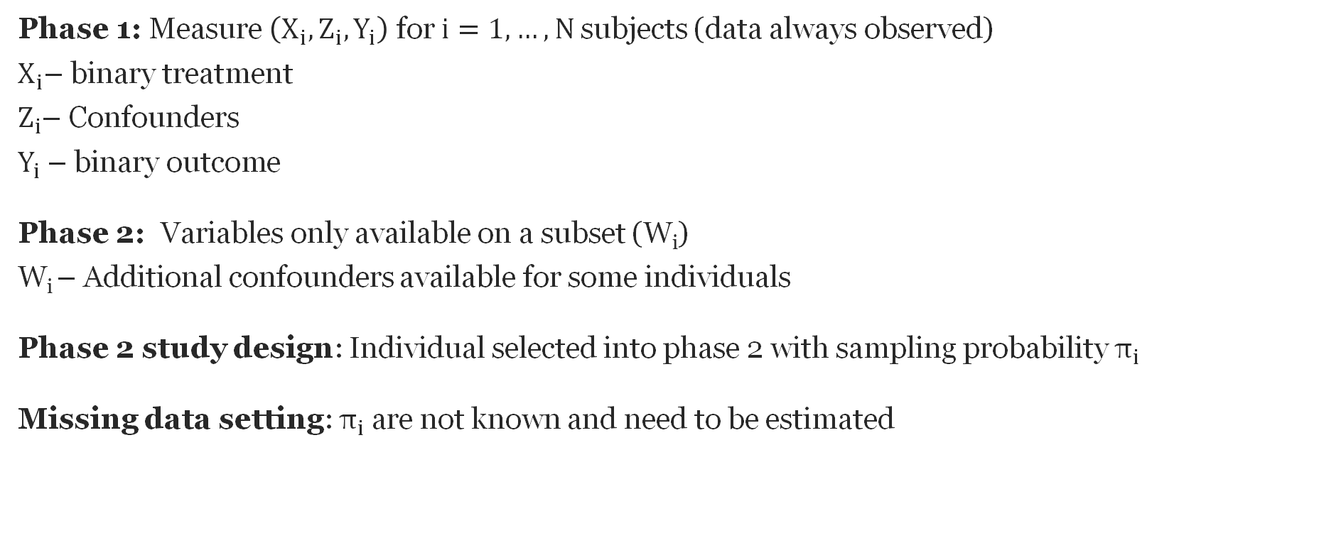
Missing data: A two-phase design
Phase 1: Measure $\left(X_{i},Z_{i},Y_{i}\right)$ for $i=1,…,N$subjects (data always observed)
$X_{i}$– binary treatment
$Z_{i}$– Confounders
$Y_{i}$ – binary outcome
Phase 2: Variables only available on a subset (W_{i})
W_{i} – Additional confounders available for some individuals
Phase 2 study design: Individual selected into phase 2 with sampling probability $π_{i}$
Missing data setting: $π_{i}$are not known and need to be estimated

Slide 12
Common approaches to handling missing confounders
Complete Case Analysis (CC)- Drop individuals with missing information for some variables
Problem #1: dropping observations with partial information can lead to inefficiency
Problem #2: dropping observations with partial information can lead to bias
Confounded Approach (CNFD) – Drop variables prone to missingness
Problem #3: dropping variables can lead to confounder bias
IPW – Horwitz Thompson inverse probability weighted estimator
Problem #1: dropping observations with partial information can lead to inefficiency
Multiple Imputation (MI) – Use partial information to impute missing data and analyze all individuals with any data
Can avoid problems 1,2,3 under MAR ( Little et al 2022)

Slide 13
Improving IPW
IPW is only using information from the complete case data
  Ignoring the partially observed data can result in inefficient estimators (wide CI)
Multiple imputation (MI) uses the partially observed data to impute missing information and incorporate all individuals into final analysis
  CI3: Weberpals et al. Clin Epi 2024 demonstrated MI estimators more efficient (narrower CI)
Han et al SIM 2021 demonstrated the efficiency of the MI comes at a cost
  Efficiency that you gain is robustness that you lose (Lumley 2017 )
Survey calibration, or generalized raking (GR) is another way to bring in information from individuals with partially observed data
  GR estimators will be more efficient than IPW if there is at least some linear correlation between observed data and unobserved data
  Unlike MI, GR does not rely on getting outcome model correct in unobserved individuals

Slide 14
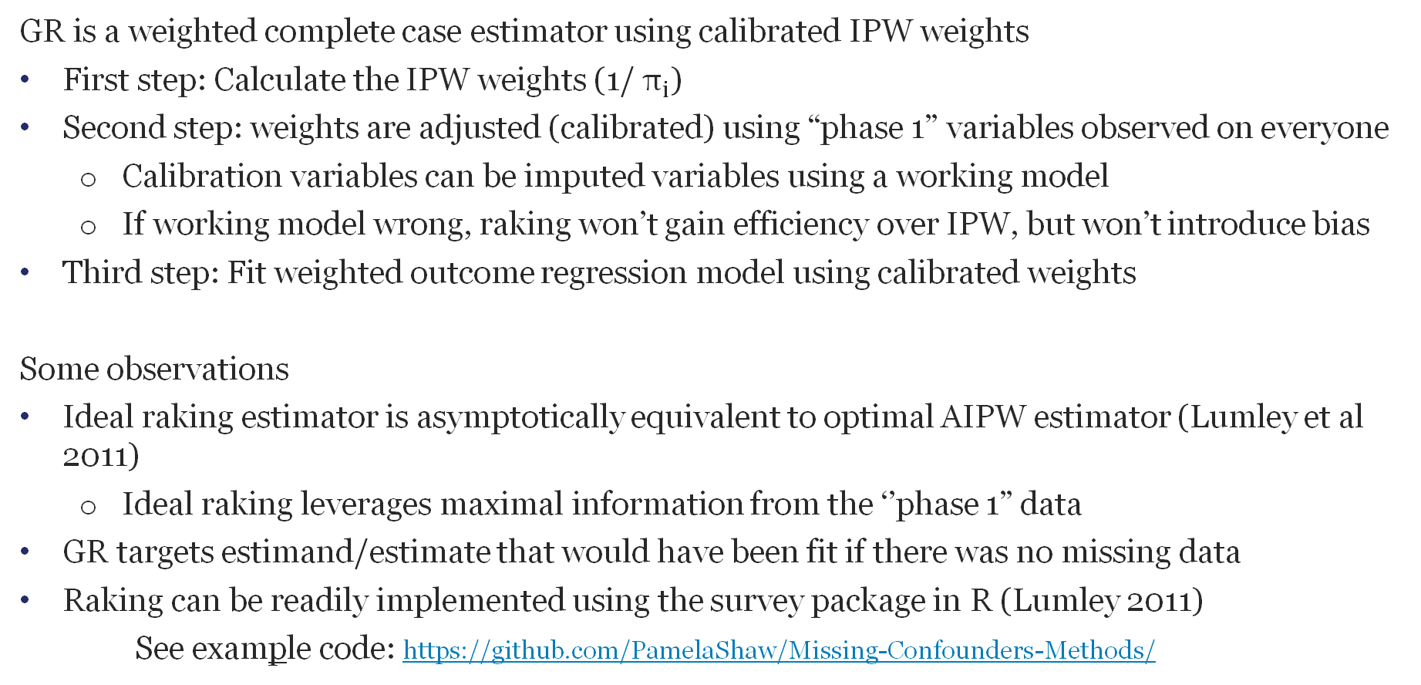
Survey Calibration, aka Generalized raking (GR)
GR is a weighted complete case estimator using calibrated IPW weights
First step: Calculate the IPW weights (1/ $π_{i}$)
Second step: weights are adjusted (calibrated) using “phase 1” variables observed on everyone
  Calibration variables can be imputed variables using a working model
  If working model wrong, raking won’t gain efficiency over IPW, but won’t introduce bias
Third step: Fit weighted outcome regression model using calibrated weights
Some observations
Ideal raking estimator is asymptotically equivalent to optimal AIPW estimator (Lumley et al 2011)
  Ideal raking leverages maximal information from the ‘’phase 1” data
GR targets estimand/estimate that would have been fit if there was no missing data
Raking can be readily implemented using the survey package in R (Lumley 2011)
See example code: https://github.com/PamelaShaw/Missing-Confounders-Methods/

Slide 15
Constructing Efficient Raking (Calibration) Variables for Regression Coefficients
We know the ideal raking variable is the expected value of the influence function given the observed data (Breslow et al 2009)
Han et al 2021 showed a practical way to estimate the optimal raking variable is to
  Multiply impute the missing data
  Fit the target working model on the population for each imputed dataset and obtain the influence functions for each model parameter
  Average the influence functions across imputed datasets
GR Approach: calibrate IPW weights using the average imputed influence functions for each of the regression coefficients

Slide 16
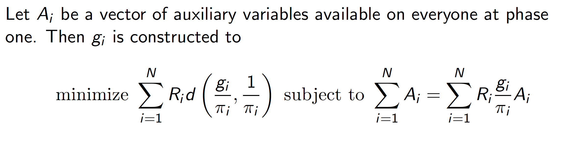
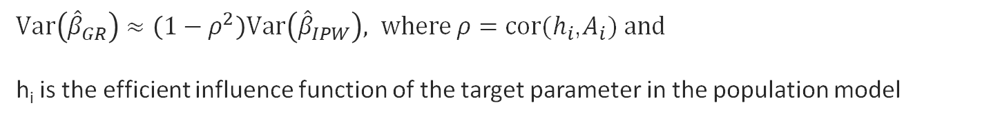
GR: Technical Bits (Deville and Särndal 1992)
Under mild regularity conditions, know
$Var\left({\hat{β}}_{GR}\right)≈\left(1−ρ^{2}\right)Var\left({\hat{β}}_{IPW}\right), where ρ=cor(h_{i}$,$A_{i}) and$
h_{i} is the efficient influence function of the target parameter in the population model

Slide 17
TMLE Superlearner
Targeted Maximum likelihood estimation (TMLE) is a semiparametric estimation technique that targets a parameter of interest
Contrary to maximum likelihood estimation (MLE) which solves an optimization problem based on all parameters, TMLE aims to reduce bias and variance for parameter of interest at expense of other parameters (nuisance parameters)
Typically implemented with a Super Learner (data adaptive ensemble learner) for key quantities
  Learning by fitting multiple models to the data
  Incorporates the flexibility of machine learning, while allowing for statistical inference
  Will be maximally efficient when the model and nuisance parameters are correctly specified
Rose and van der Laan (2011) developed a TMLE approach to handle two-phase designs
Machine learning principles can be used to flexibly model missing data
Key references: van der Laan and Rubin 2006; van der Laan et al 2007; Rose and van der Laan 2011, Gruber and van der Laan 2009

Slide 18
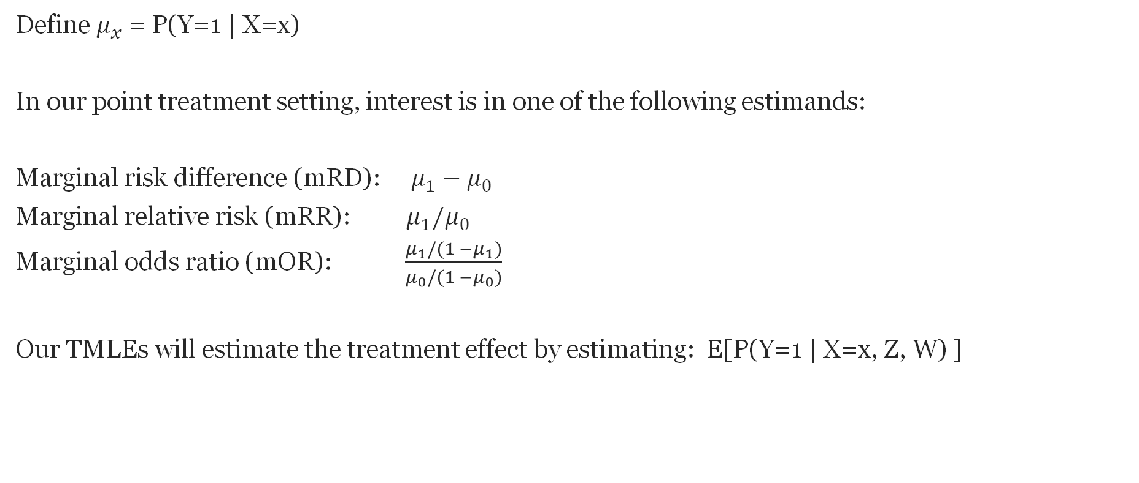
TMLE targets the causal estimand
Define $μ_{x}$ = P(Y=1 | X=x)
In our point treatment setting, interest is in one of the following estimands:
Marginal risk difference (mRD): $μ_{1}−μ_{0}$
Marginal relative risk (mRR): $μ_{1}/μ_{0}$
Marginal odds ratio (mOR):$\frac{μ_{1}/(1 −μ_{1})}{μ_{0}/(1 −μ_{0})}$
Our TMLEs will estimate the treatment effect by estimating: E[P(Y=1 | X=x, Z, W) ]

Slide 19
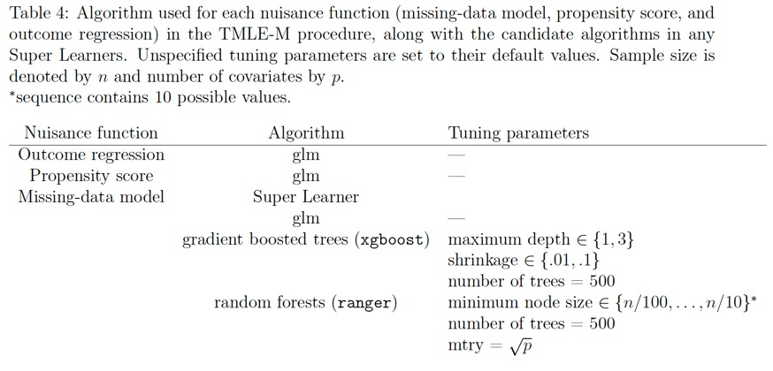
TMLE for Missingness Mechanism (TMLE-M)

Slide 20
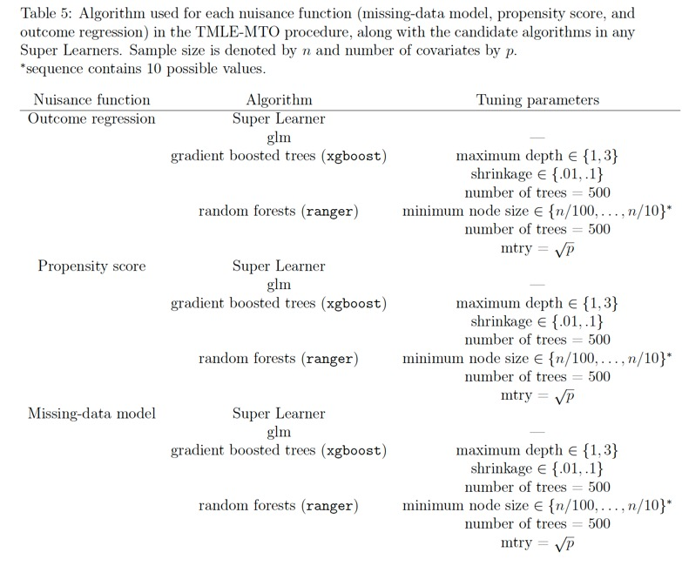
TMLE for Missing/Treatment/Outcome (TMLE-MTO)

Slide 21
Numerical Study Part 1: Synthetic Data

Slide 22
Base Case Simulation Set up
Cohort of N= 10,000 generated
2500 Monte Carlo simulation iterations
Roughly 40% missingness in confounders
Outcome ~12% incidence
Compare performance of estimation methods for 4 estimands
  Conditional odds ratio (cOR)- i.e., canonical parameter from logistic regression model
  Marginal risk difference (mRD)
  Marginal risk ratio (mRR)
  Marginal odds ratio (mOR)
Consider the mean bias, median bias, ESE, MAD, RMSE, Oracle coverage, Nominal coverage
Base Scenario: Simple data generating models (DGMs) for outcome, propensity and missingness
Variations: Complex outcome and missingness models, increased missingness (80%), lower outcome incidence (5%)

Slide 23
Estimators Under Study
Oracle model – true outcome model fit with complete data for whole cohort (unobserved, Benchmark model for Oracle estimand)
Population model –working outcome model fit with complete data for whole cohort (unobserved- Benchmark model for Census estimand)
Confounded model (CFND)- working model dropping confounders with missing data
Complete case (CC) - working model dropping observations with missing data
Inverse Probability Weighting (IPW) – working model using CC data and glm-derived IP weights
Generalized Raking (GR) – working model using CC data and calibrated weights
MICE – working model using Multiple Imputation (MI) with chained equations (MICE)
MI-RF – working model using MI with random forest
MI-XGB – working model with MI with gradient boosted trees (XGBoost)
TMLE-M – working model using CC data and super learner-derived IPW weights
TMLE -MTO – super learner-derived IP weights, propensity score (PS) weights and outcome model
Notes:
Consider modification: for TMLE and a marginal structural model if you decided that you were interested

Slide 24
Leveling the Playing Ground (1)
Different methods target different estimands, so important to study both
Conditional vs marginal estimands:
  Conditional estimands (e.g. cOR) are commonly a target of inference, typically coefficient from a regression model
  Marginal estimands (e.g. mRD) are commonly the focus of causal inference
Census vs Oracle estimands:
  Census estimand is a traditional target of missing data methods. Benchmark model – the working model fit to the unobserved full cohort data
  Oracle estimand is a scientific ideal, capturing “true” DGM. A fully non-parametric model generally necessary if targeting the oracle estimand
Common implementations:
  CC, IPW, MI, GR- targeting census, conditional estimand
  TMLE-MTO- targeting oracle, marginal estimand

Slide 25
Leveling the Playing Ground (2)
Census estimand specified by working model, so simpler DGM will make it easier to get this right
Oracle estimand- specified by unknown true DGM, need flexibility to get this right-so more complex DGM will favor more flexible methods (e.g. super learners)
Features of Numerical Simulation Studies
In Synthetic simulations, we considered both complex and simple DGM
In Plasmode simulations, we fit very complex DGM to the real data
Plasmode simulation had complex relationships between covariates, but synthetic simulations had stronger treatment effects and stronger confounding mechanisms, and perhaps stronger patterns of non-linearity than fitted plasmode models

Slide 26
Data Generation Mechanism (DGM) Scenarios
Scenarios | Missingness Model | Treatment Model | Outcome Model | Implications for analysis model
Simple Parametric models No unmeasured confounders in treatment model | 1.0 Logistic, simple MAR-XZ 1.1 Logistic, simple MAR-XZY | linear logistic model no unobserved confounding | Linear logistic model 1.0- null effect 1.1- cOR=1.5 | Will allow for correct parametric model specification
Complex | MAR: Interactions and non-linear terms MNAR- value MNAR- unobserved variable | N/A | Interactions and non-linear terms MNAR Scenario: unobserved variable | Analysis model simpler than DGM
Plasmode | Complex Tree-based and glm-based implementations for DGM. | Complex Tree-based and glm-based implementations for DGM. | Complex Tree-based and glm-based implementations for DGM. | Analysis model simpler glm than DGM

Slide 27
Analysis Choices
Missingness
Methods
Subset calibration
MI
TMLE Superlearner
Treatment
Confounder Adjustment
Outcome
Simple logistic working model

Slide 28
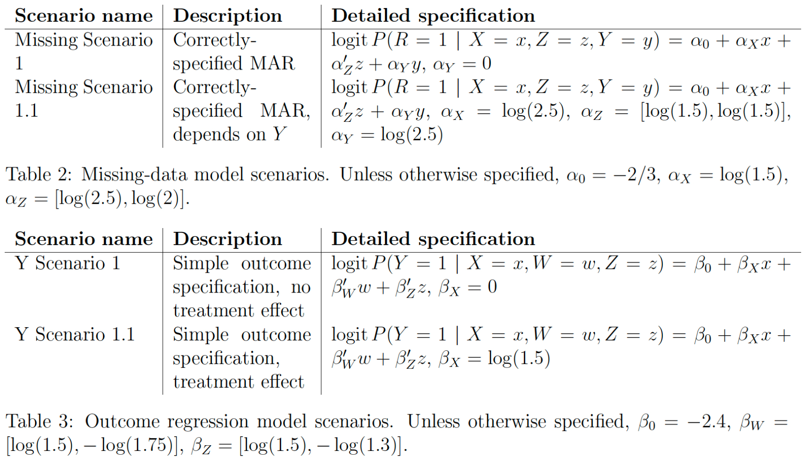
Simple Scenario: Outcome and Treatment DGM

Slide 29
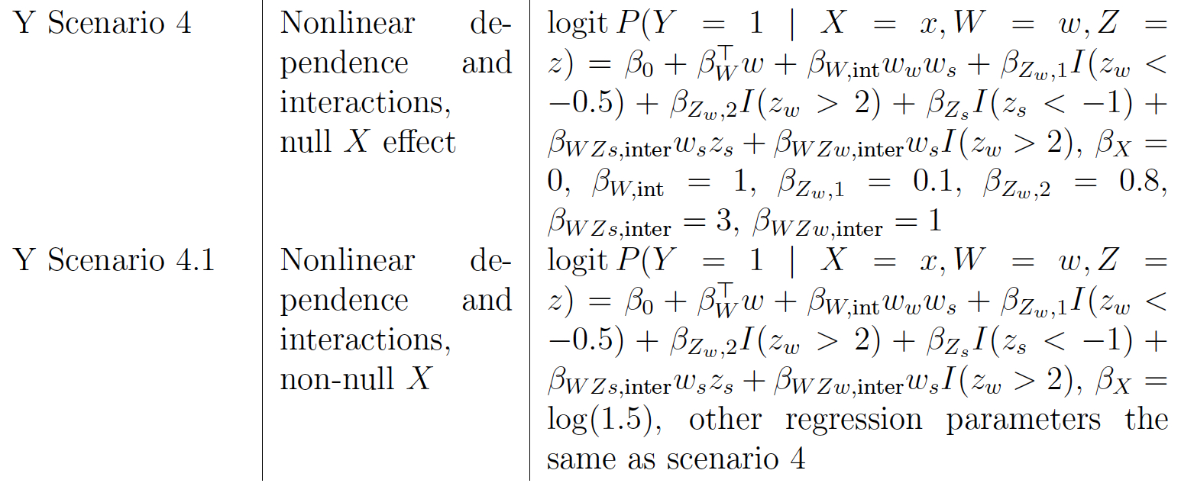
Complex Outcome Model : Nonlinearity + Interactions

Slide 30
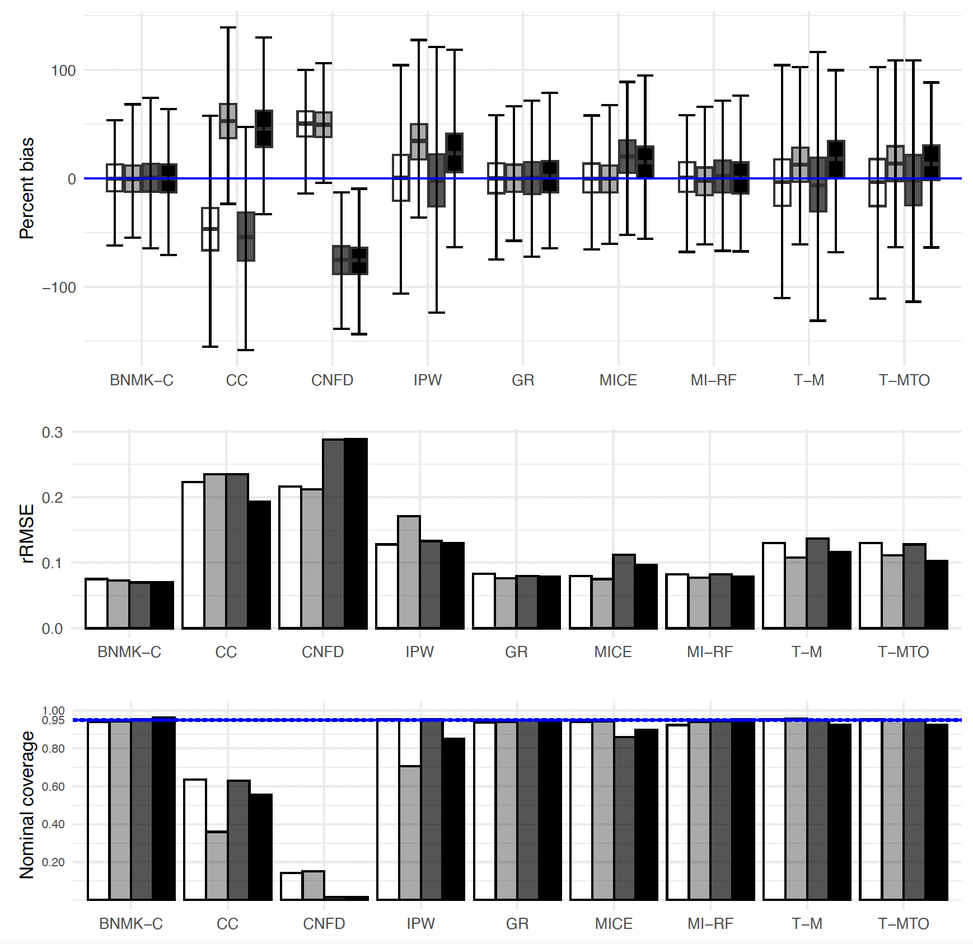


Base Case – MAR, Census clogOR
Simple MAR, Simple Outcome
Complex MAR, Simple Outcome
Simple MAR, Complex Outcome
Complex MAR, Complex Outcome
Remarks:
Estimators achieving close to 95% coverage in all 4 scenarios: IPW, GR, MI-RF, T-M, T-MTO
Most efficient among these: MI-RF
Mice doing well when outcome model is simple

Slide 31
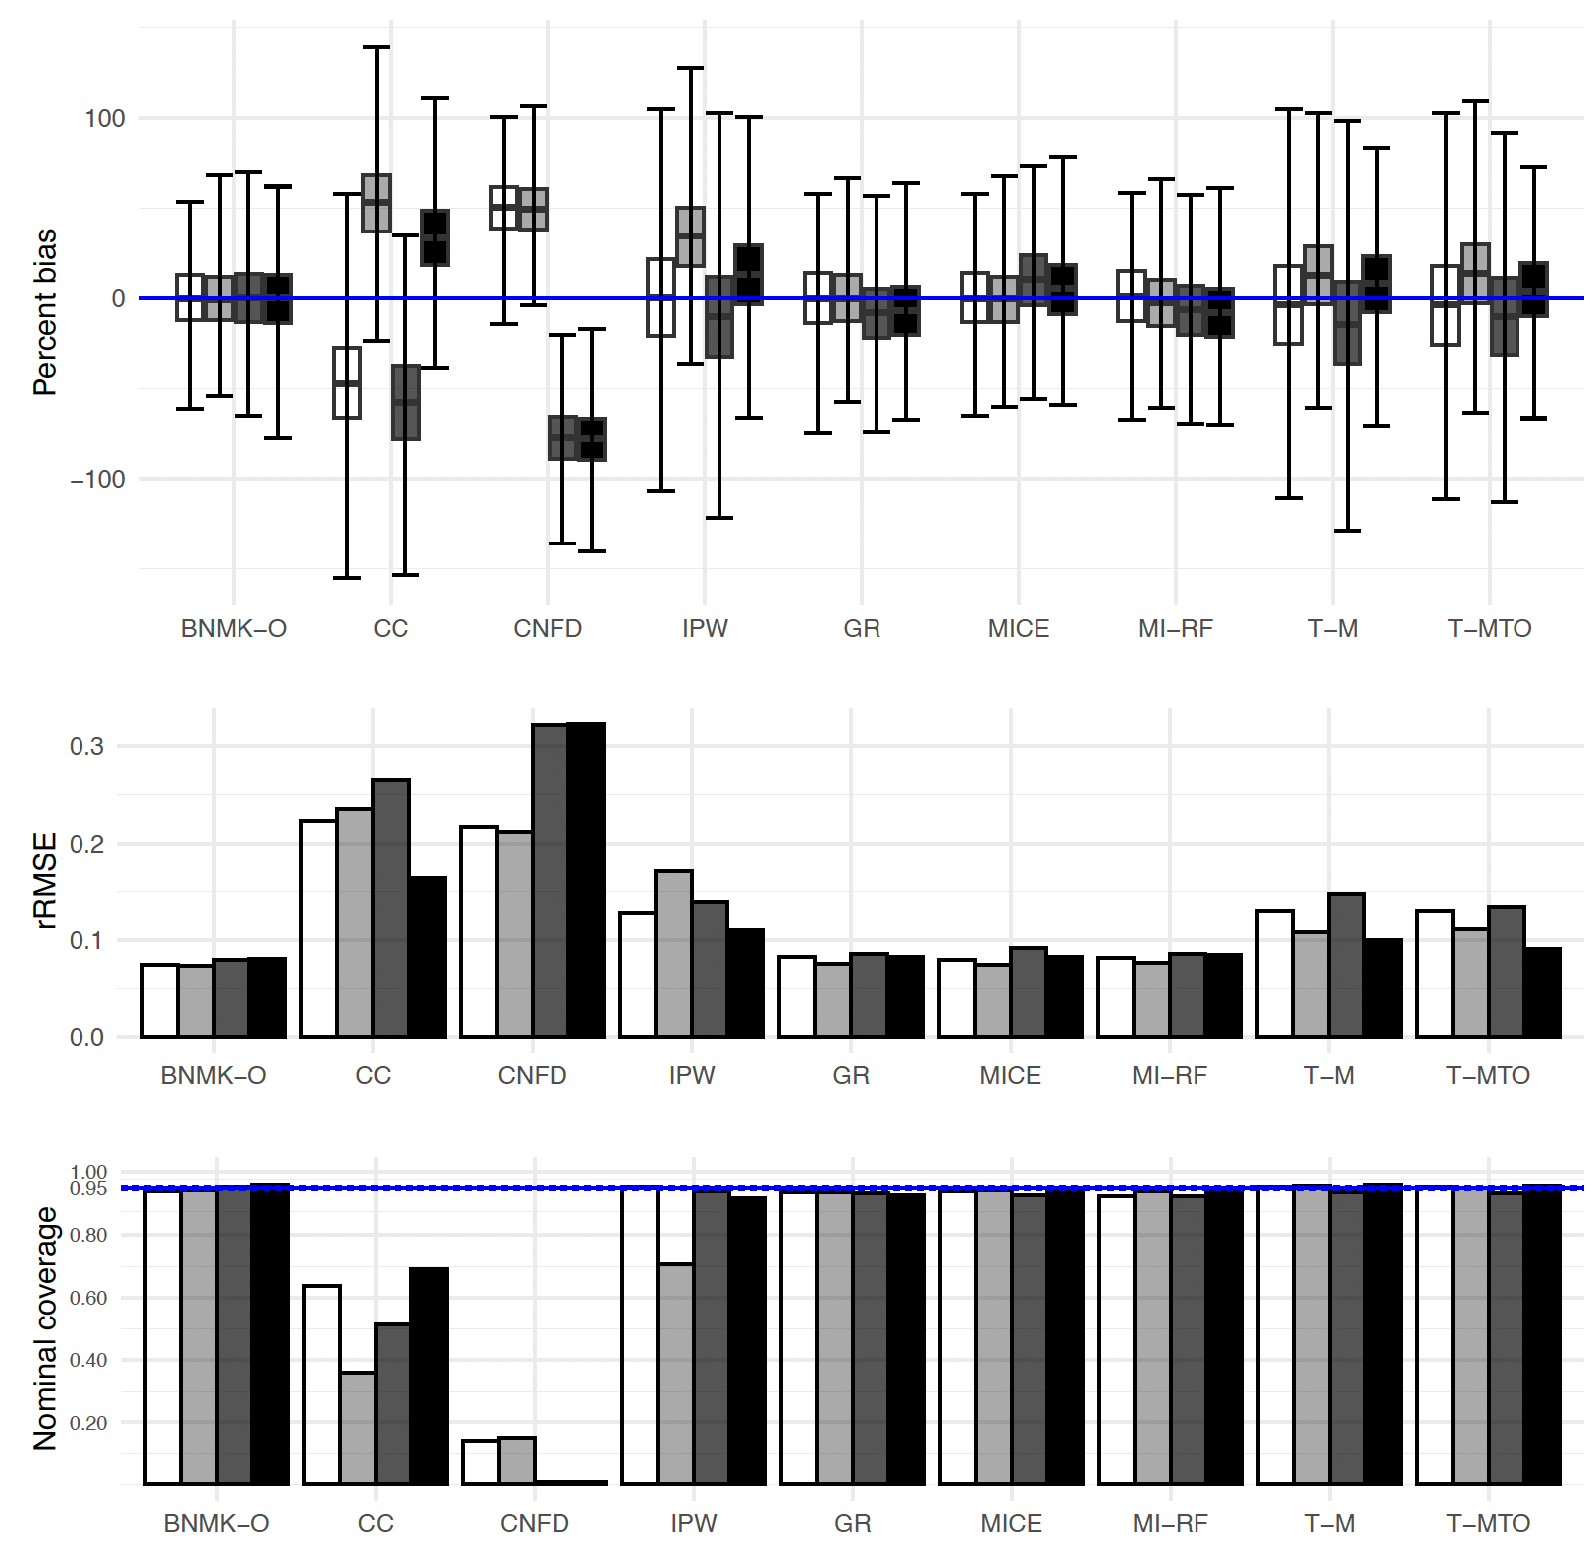
Base Case – MAR, Oracle clogOR
Simple MAR, Simple Outcome
Complex MAR, Simple Outcome
Simple MAR, Complex Outcome
Complex MAR, Complex Outcome
Remarks:
GR still doing well. MICE now doing better

Slide 32
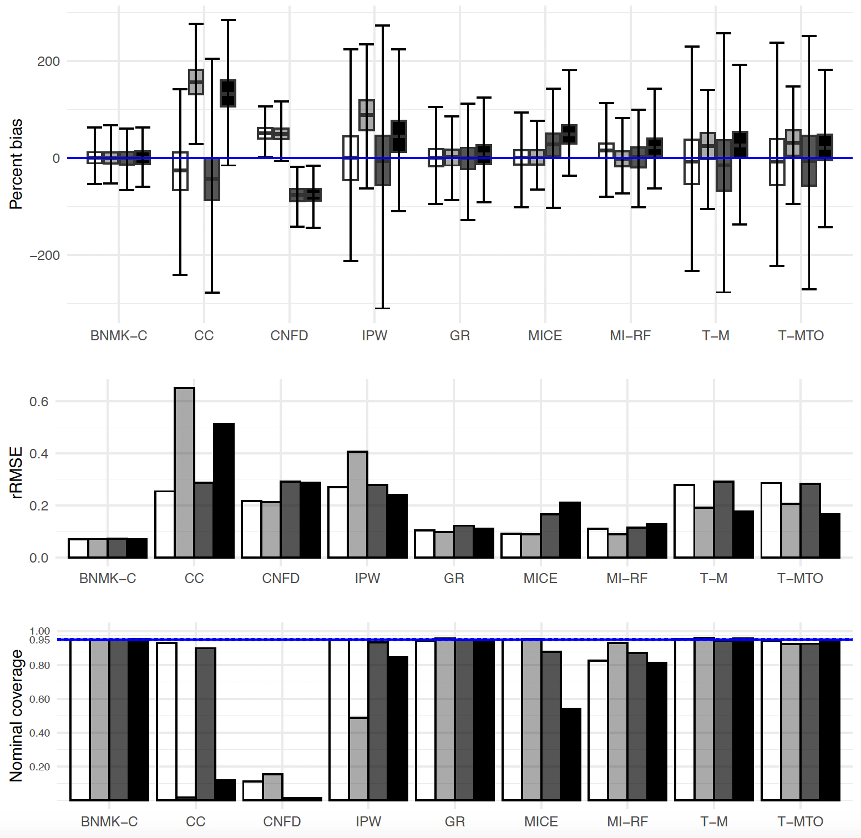
Base Case with 80% missingness– MAR, Census clogOR
Simple MAR, Simple Outcome
Complex MAR, Simple Outcome
Simple MAR, Complex Outcome
Complex MAR, Complex Outcome
Remarks:
Similar to case with 40% missingness, except MI-RF not doing well any longer

Slide 33
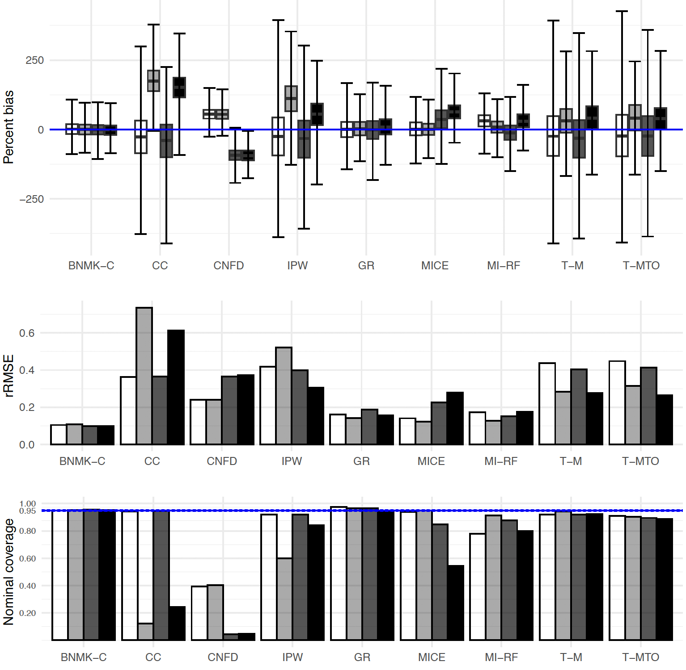
80% missingness + rare outcome: MAR, Census clogOR
Simple MAR, Simple Outcome
Complex MAR, Simple Outcome
Simple MAR, Complex Outcome
Complex MAR, Complex Outcome
Remarks:
GR still does well, some SE inflation
Both MI fail to achieve 95% coverage with complex outcome. MI-RF doing worse
TMLE having some coverage issues, won't do well under complex MAR

Slide 34
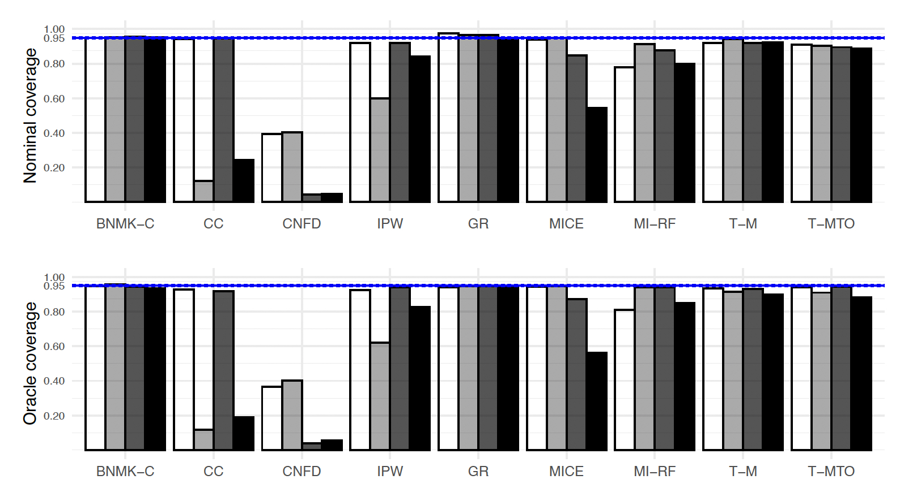
Oracle vs Nominal Coverage
Simple MAR, Simple Outcome
Complex MAR, Simple Outcome
Simple MAR, Complex Outcome
Complex MAR, Complex Outcome
Remarks:
Can see some SE estimation problems for MICE, MI-RF, T-M, T-MTO
Can see double-robustness of TMLE when missingness is correct

Slide 35
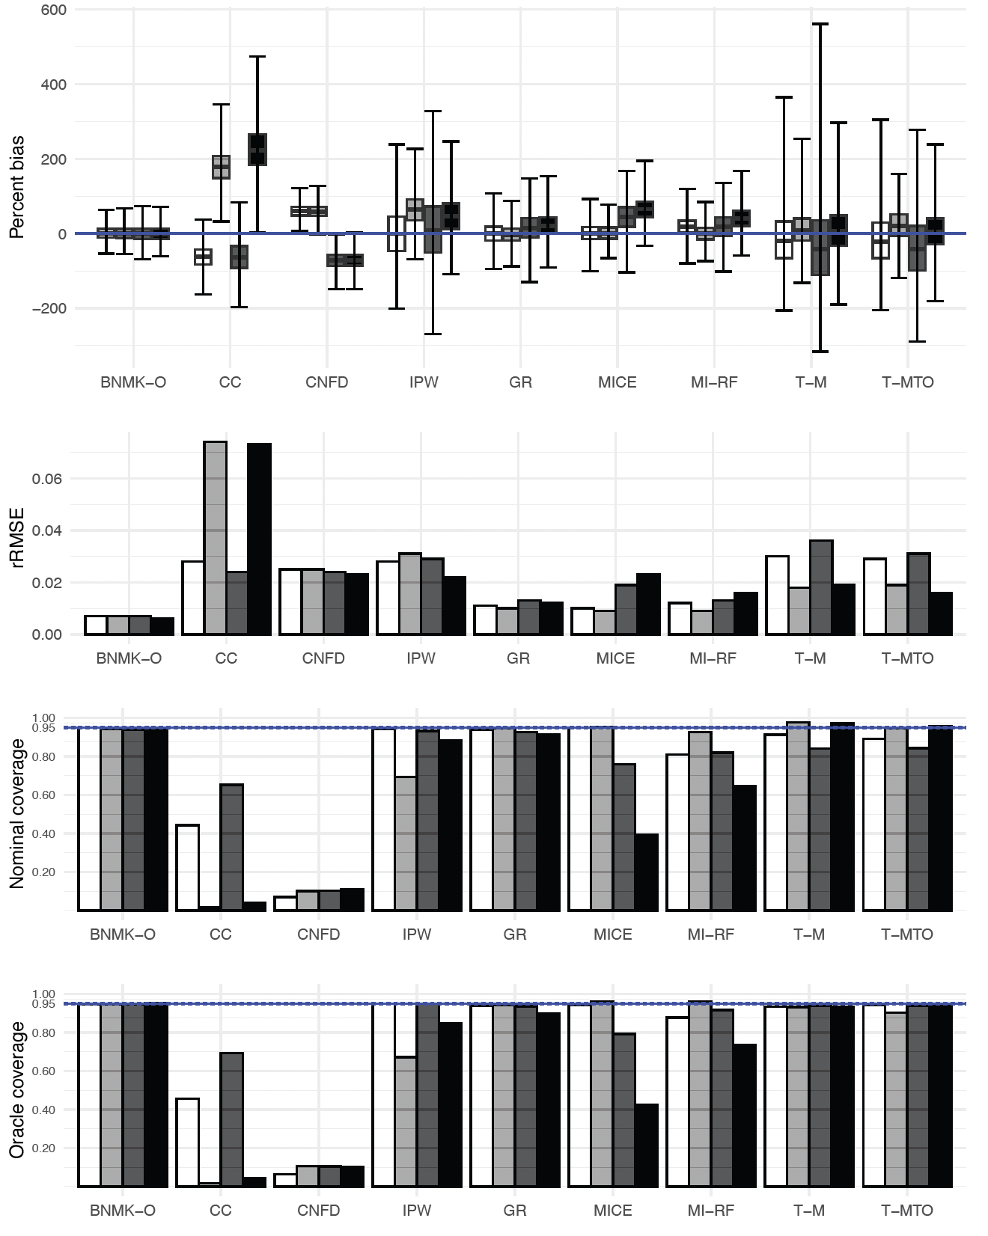
Base Case – MAR, Oracle mRD
Simple MAR, Simple Outcome
Complex MAR, Simple Outcome
Simple MAR, Complex Outcome
Complex MAR, Complex Outcome
Remark:
GR achieving close to 95% coverage in all 4 scenarios:

Slide 36
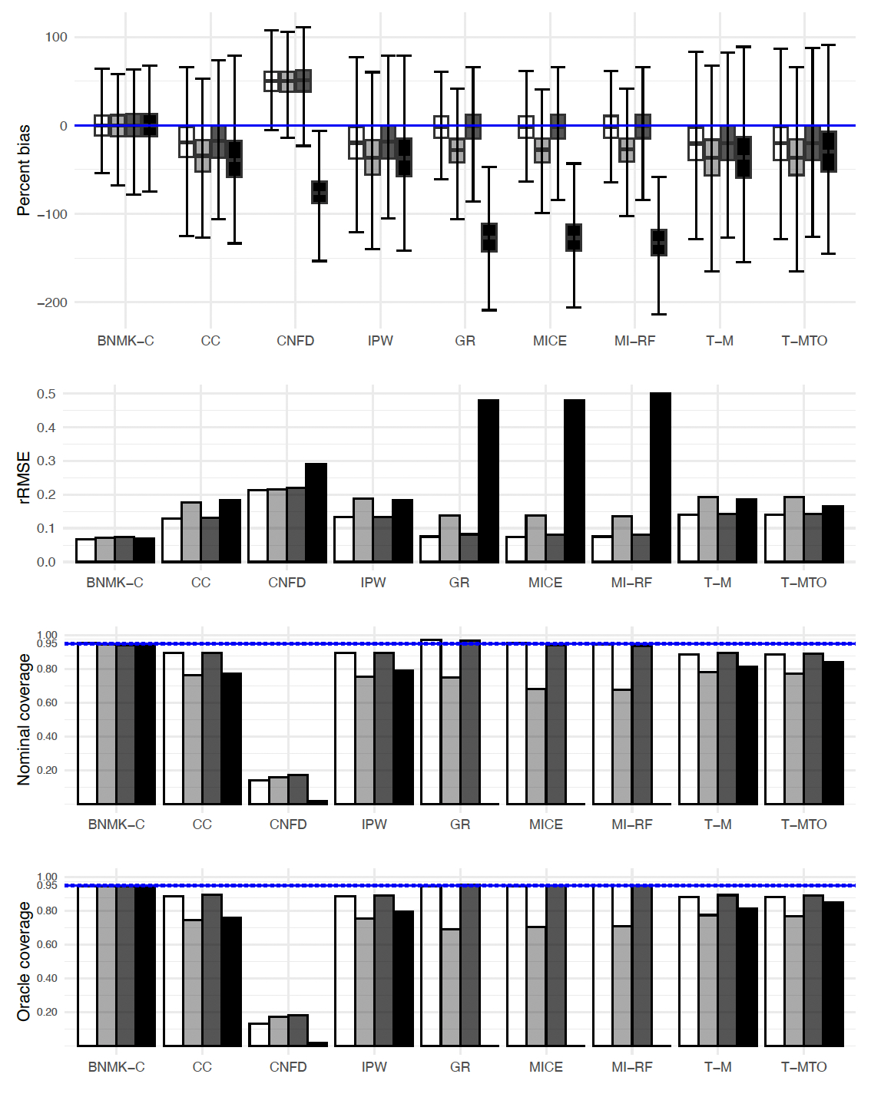
MNAR – 12% incidence, 40% missing,
Census clogOR
MNAR unobserved, Correct simple Outcome
MNAR value, , Incorrect simple Outcome
MNAR unobserved, Incorrect simple Outcome
MNAR value, Incorrect simple Outcome
Remark:
TMLE had the lowest bias and best overall coverage
GR/MI doing well for MNAR unobserved
For oracle estimators TMLE also showing good efficiency (data not shown)

Slide 37
Takeaways for Raking vs MI vs TMLE from Synthetic Simulations -MAR
Simple MAR, all estimands
Raking and MI did well and similarly for simple (correctly specified) outcome
Raking outperformed MI for complex (incorrectly specified) outcome
TMLE-M, TMLE-MTO did well with respect to bias, but not efficiency
Complex MAR, all estimands
Raking did well for census estimands and all estimands with simple (correct) outcome model
Raking still does well for census estimands and cOR, even with complex (incorrect) outcome
Bias and SE estimation issues for MI with complex (incorrectly specified) outcome model
TMLE outperformed other estimators for Oracle marginal estimands in terms of coverage and bias. Efficiency good for larger sample size and less missing data.
A few instances of under coverage for TMLE

Slide 38
Takeaways for Raking vs MI vs TMLE from Synthetic Simulations -MNAR
Raking still does well for several settings for census estimand (in terms of efficiency and coverage)
TMLE does well, with notable resilience , for case of the oracle marginal estimands
MI performance was not consistent in terms of which imputation algorithm did well/sufficiently

Slide 39
A Few Qualifiers
In complex settings studied, conclusions are specific to the flavor of the complex model implemented.
  e.g., raking did well even for Oracle estimand under misspecification. But for more extreme misspecification, might not expect that
"Happy families are all alike; every unhappy family is unhappy in its own way”
-Tolstoy, Anna Karenina

Slide 40
Numerical Study Part 2: Plasmode Data

Slide 41
Plasmode Simulation
Plasmode simulation is a type of numerical simulation that generates the covariate distribution by resampling real data (Franklin et al 2014)
The specific association of interest is then injected into the data using statistical models
In our setting we will create 1000 bootstrap samples of the KPWA ADI cohort data
Still need 3 DGM
  Missingness model
  Treatment model
  Outcome model
We will compare the same estimation methods as done for the synthetic data
  XGBoost did not perform that well so was dropped

Slide 42
Plasmode Data Generating Mechanisms (DGMs)
Treatment data generating model
  Antidepressant medication or psychotherapy
Outcome data generating model
  Self-harm/Psychiatric hospitalization within 5 years of treatment initiation
Missing data generating model
  PHQ-9 measurement (yes/no)
Data generating models estimated from KPWA ADI Cohort
  Treatment and outcome model fit to 50,337 with complete data
  Missing data model considers full population of 112,770 individuals with 50,337 (45%) having complete data
For each type of generating model use ADI cohort to estimate:
  Parametric model (e.g. logistic regression) with interactions
  Tree-based model (allowing for complex interactions)
DGM more complex and had more variables than analysis models

Slide 43
Confounders
Sex (mostly represents sex assigned at birth)
Age in years at time of index visit (18-24, 25-34, 35-44, 45-54, 55-64, 65+ years)
Charlson comorbidity index (0, 1, 2, 3+)
Anxiety diagnosis in the past year
Self-harm in the prior 6 months
Psychiatric hospitalization in the prior 5 years
Alcohol use disorder in the past year
9 item Patient Health Questionnaire (PHQ-9)
    Sum of first 8 items to summarize depressive symptoms (PHQ-8)
    9th item measure of suicidal ideation

Slide 44
Covariates Included in the DGMs for Outcome, Treatment, and Missingness
Treatment exposure + 8 confounders
Interactions:
  Categorical age and sex
  Prior self-harm and sex
  Prior self-harm and categorical age
  PHQ 9th item and sex
  PHQ 9th item and prior self-harm

Slide 45
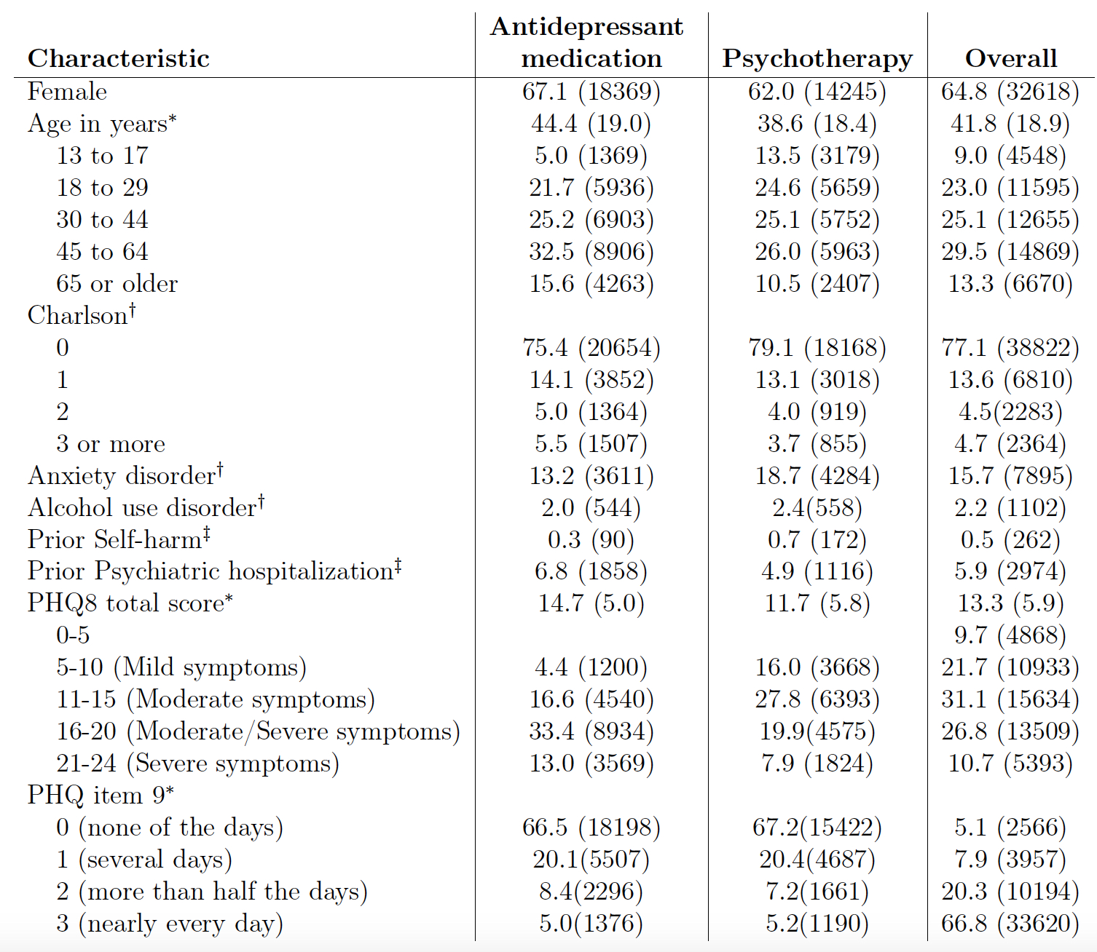
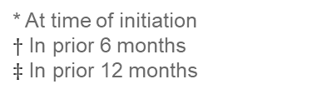
KPWA ADI Cohort (N=50,337)
% (n)
* At time of initiation
$†$ In prior 6 months
$‡$ In prior 12 months

Slide 46
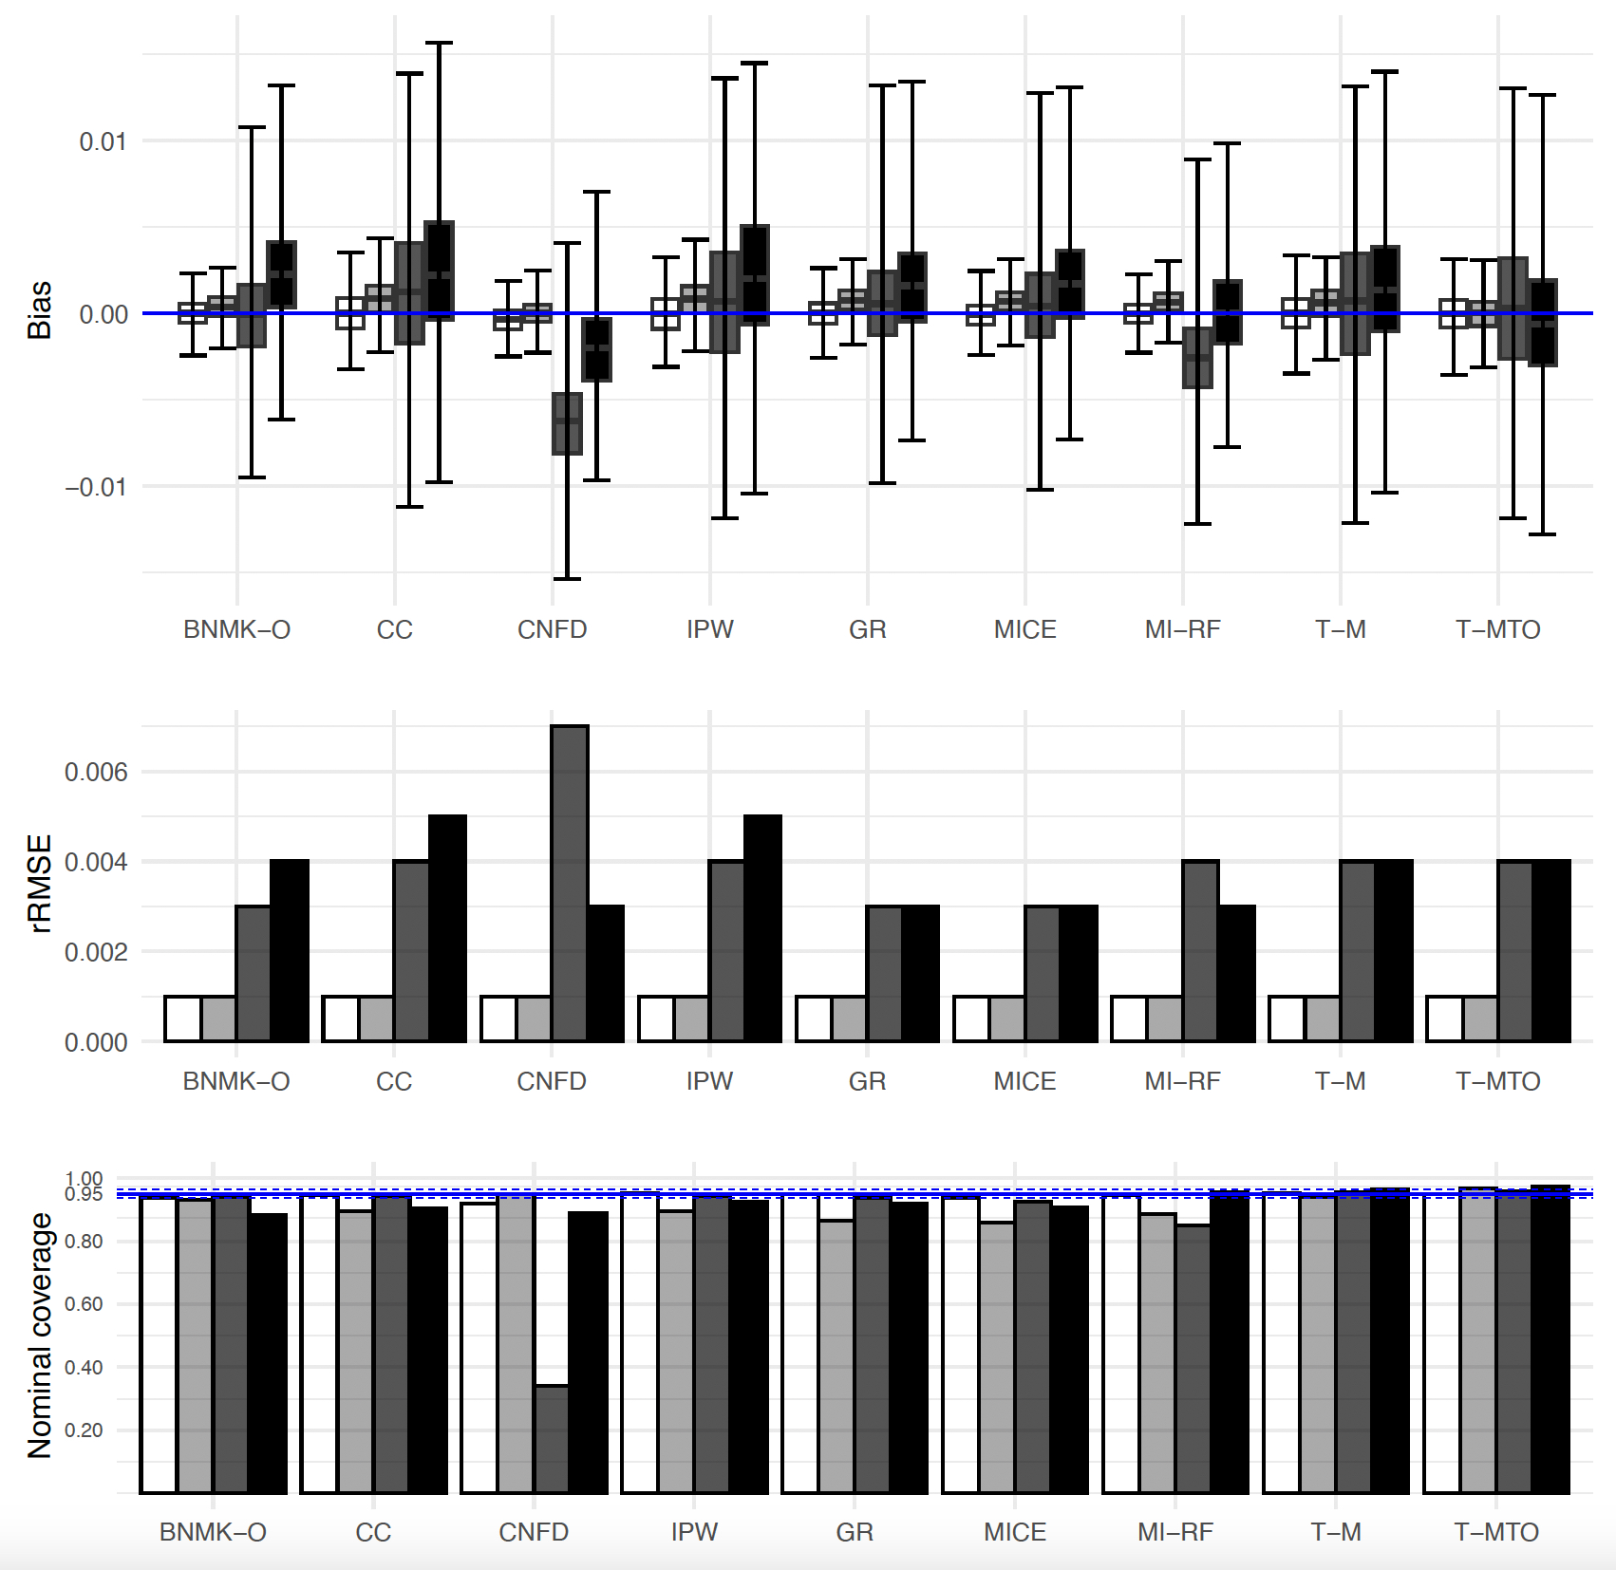
Plasmode results, Oracle mRD
GLM 1-year self-harm
Tree 1-year self-harm
GLM 5-year self-harm/hospitalization
Tree 5-year self-harm/hospitalization
Remarks:
For 5-year outcome: MICE and GR behaved similarly and maintained best performance across all estimands
For 1-year outcome: TMLE-MTO maintained best overall coverage. Most efficient estimator that maintained nominal coverage for Oracle mRD and tree DGM

Slide 47
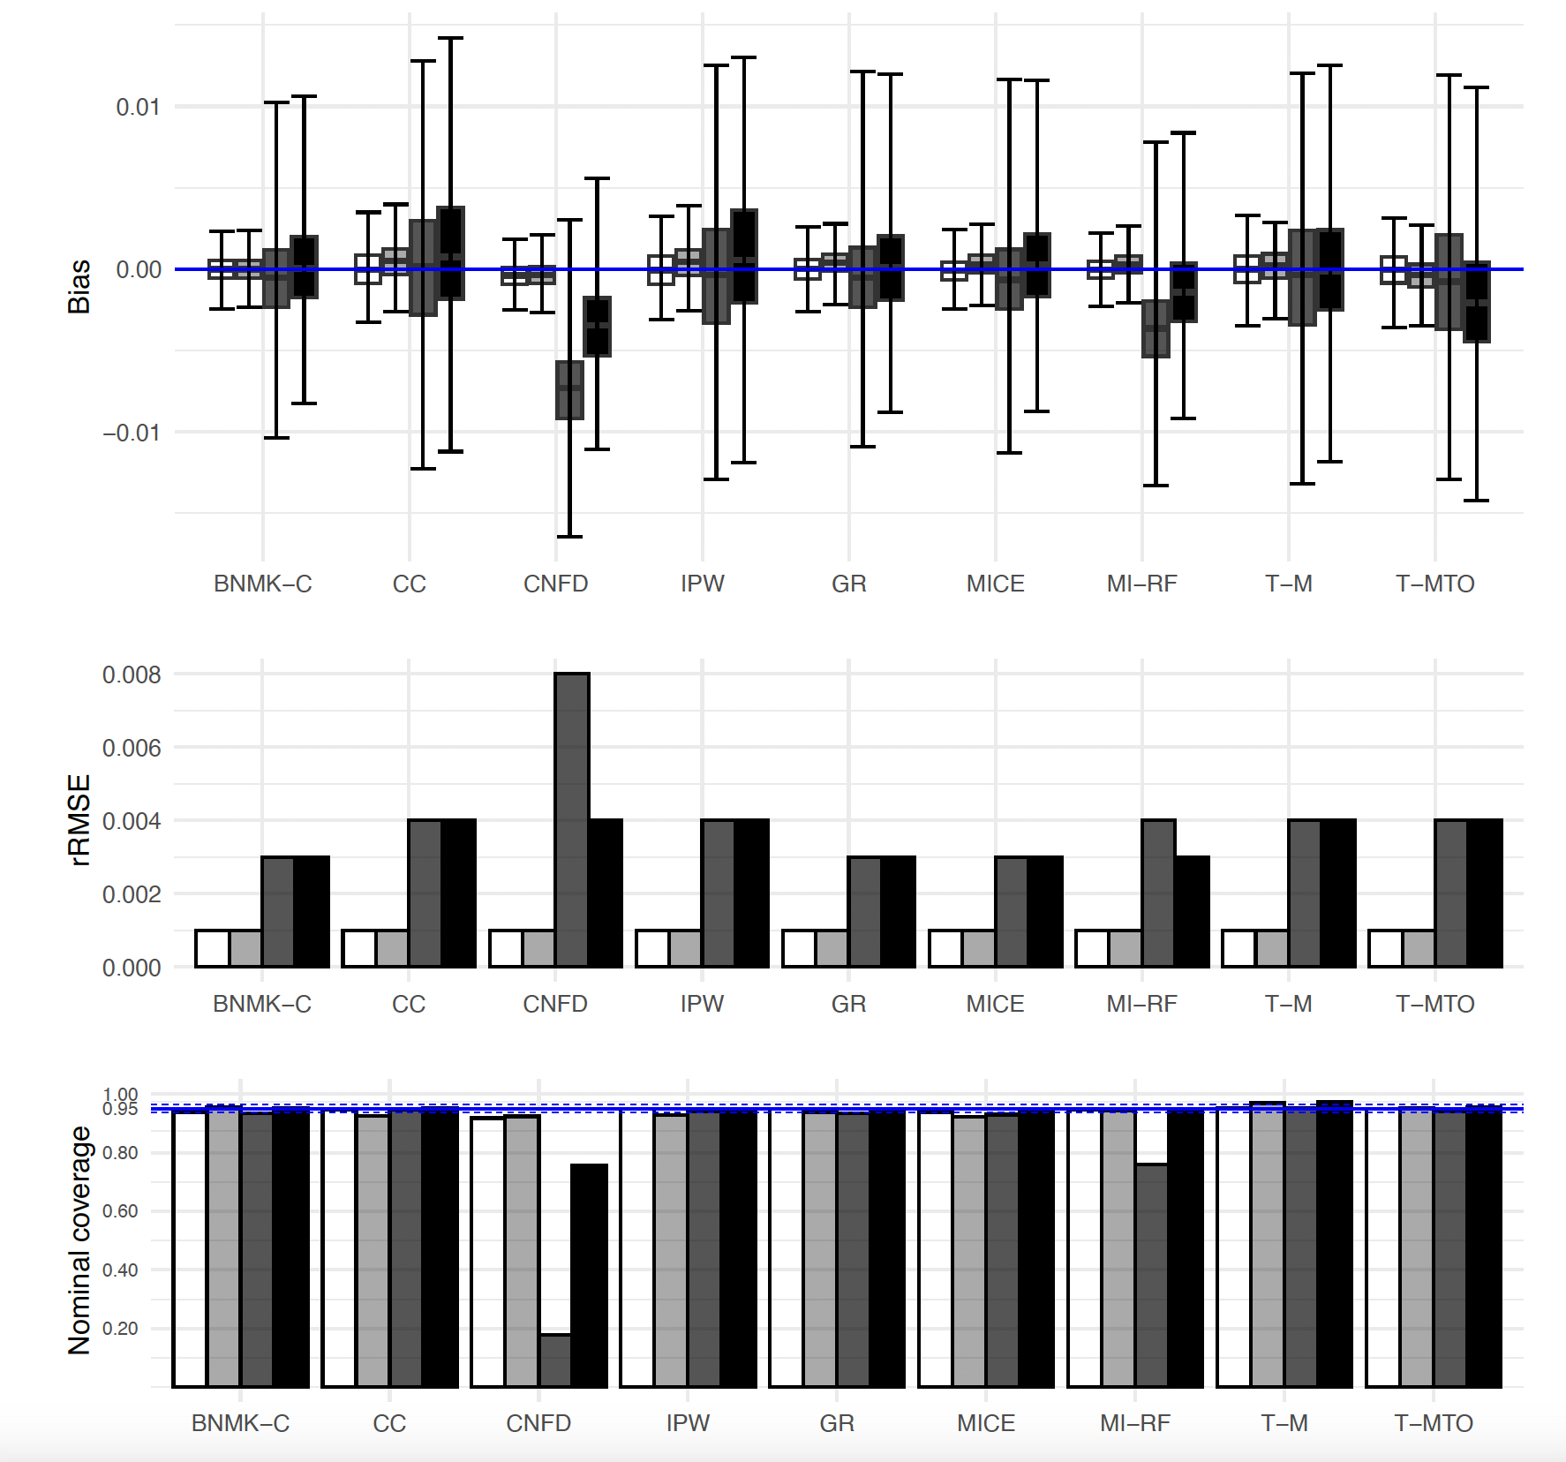
Plasmode results, Census mRD
GLM 1-year self-harm
Tree 1-year self-harm
GLM 5-year self-harm/hospitalization
Tree 5-year self-harm/hospitalization

Slide 48
Watch this space
https://github.com/PamelaShaw/Missing-Confounders-Methods/
We will be providing R code that implemented these methods
We will also provide vignettes that explain in detail the general principles and steps to applying these methods
Contact pamela.a.shaw@kp.org for further information

Slide 49
Conclusions
Survey calibration/Generalized raking are rarely performed in biomedical settings, but were observed to have the best overall performance in the majority of settings
  These estimators are practical to implement in standard software
TMLE did well with respect to bias, but only did well with respect to efficiency in certain settings
  Was efficient for oracle estimand mRD when there were complex DGMs and larger sample size/event rates
One strategy may be to perform TMLE and raking, gaining confidence when estimates agree
  When estimates don’t agree, it may be missingness model is misspecified, or oracle and census estimands are different
MI often did well with respect to efficiency but no one algorithm did well across all the settings
Confounded and complete case approaches were generally poor performing methods
There were a few edge cases (MNAR) where complete case and IPW did well (discussed by Little et al 2022, Lee et al 2023, and others)
Our numerical experiments highlight the importance of first choosing a target estimand and then determining an estimation procedure.
Plasmode simulation studies are useful in guiding methods selection, but need to consider DMGs that don’t uniformly favor one method
Scenarios studied are comprehensive, but not exhaustive

Slide 50
Thank You
Pamela Shaw, MS, PhD
Pamela.A.Shaw@kp.org

Slide 51
Useful recent papers
Little RJ, Carpenter JR, Lee KJ. A comparison of three popular methods for handling missing data: complete-case analysis, inverse probability weighting, and multiple imputation. Sociological Methods & Research. 2022 Aug 5:00491241221113873.
Discusses what to expect under MAR and MNAR, highlighting when each method may be expected to do well
Some interesting special (edge?) cases where IPW or CC can beat MI
Weberpals J et al A Principled Approach to Characterize and Analyze Partially Observed Confounder Data from Electronic Health Records. Clinical Epidemiology. 2024 Dec 31:329-43.
CI3 paper that looked at methods performance under MAR and MNAR
Simulating MNAR that causes lots of bias can be difficult
Forthcoming Weberpals et al paper saw high dimensional auxiliary data approach offered marginal improvements
Lee, Katherine J., et al. "Assumptions and analysis planning in studies with missing data in multiple variables: moving beyond the MCAR/MAR/MNAR classification." International Journal of Epidemiology 52.4 (2023): 1268-1275.
Outlines that MAR and MNAR can be unhelpful distinctions and need to think about causal diagrams

Slide 52
References: Missing Data
Getz K, Hubbard RA, Linn KA. Performance of Multiple Imputation Using Modern Machine Learning Methods in Electronic Health Records Data. Epidemiology. 2023 Mar:10-97.
Little RJ, Carpenter JR, Lee KJ. A comparison of three popular methods for handling missing data: complete-case analysis, inverse probability weighting, and multiple imputation. Sociological Methods & Research. 2022 Aug 5:00491241221113873.
Bartlett J, Keogh R., and Bonneville EF. Smcfcs: Multiple Imputation of Covariates by Substantive Model Compatible Fully Conditional Specification. R package version 1.7.1; 2022. https://CRAN.R-project.org/package=smcfcs.
Lee KJ, Tilling KM, Cornish RP, Little RJ, Bell ML, Goetghebeur E, Hogan JW, Carpenter JR. Framework for the treatment and reporting of missing data in observational studies: The Treatment And Reporting of Missing data in Observational Studies framework. Journal of clinical epidemiology. 2021 Jun 1;134:79-88.
Aleryani A, Wang W, De La Iglesia B. Multiple imputation ensembles (MIE) for dealing with missing data. SN Computer Science. 2020 May;1:1-20.
Van Buuren, S. (2018). Flexible Imputation of Missing Data. Second Edition. Chapman & Hall/CRC. Boca Raton, FL.
Bartlett JW, Seaman SR, White IR, Carpenter JR, Alzheimer's Disease Neuroimaging Initiative*. Multiple imputation of covariates by fully conditional specification: accommodating the substantive model. Statistical methods in medical research. 2015 Aug;24(4):462-87.
Seaman SR, White IR. Review of inverse probability weighting for dealing with missing data. Statistical methods in medical research. 2013 Jun;22(3):278-95.
Carpenter JR, Kenward MG. Missing data in randomised controlled trials: a practical guide. 2007

Slide 53
References: 2-Phase Design
Lumley T, Shaw PA, Dai JY. Connections between survey calibration estimators and semiparametric models for incomplete data. International Statistical Review. 2011; 79 (2): 200–220.
Robins JM, Rotnitzky A, Zhao LP. Estimation of regression coefficients when some regressors are not always observed. Journal of the American Statistical Association. 1994 Sep 1;89(427):846-66.
Han K, Shaw PA, Lumley T. Combining multiple imputation with raking of weights: An efficient and robust approach in the setting of nearly true models. Statistics in Medicine. 2021;;40(30):6777-91.
Särndal CE, Swensson B, Wretman J. Model assisted survey sampling. Springer Science & Business Media; 2003.
Deville JC, Särndal CE. Calibration estimators in survey sampling. Journal of the American Statistical Association. 1992 Jun 1;87(418):376-82.
Deville JC, Särndal CE, Sautory O. Generalized raking procedures in survey sampling. Journal of the American statistical Association. 1993 Sep 1;88(423):1013-20.
Breslow NE, Lumley T, Ballantyne CM, Chambless LE, Kulich M. Improved Horvitz–Thompson estimation of model parameters from two-phase stratified samples: applications in epidemiology. Statistics in Biosciences. 2009 May;1(1):32-49.
Breslow NE, Lumley T, Ballantyne CM, Chambless LE, Kulich M. Using the whole cohort in the analysis of case-cohort data. American Journal of Epidemiology. 2009 Jun 1;169(11):1398-405.
Rose S, van der Laan MJ. A targeted maximum likelihood estimator for two-stage designs. The International Journal of Biostatistics. 2011 Mar 11;7(1).
Lumley T. Robustness of semiparametric efficiency in nearly-true models for two-phase samples; 2017. ArXiv e-prints arXiv: 1707.05924.

Slide 54
References: Propensity / Probability of Treatment
Stephens DA, Nobre WS, Moodie EE, Schmidt AM. Causal inference under mis-specification: adjustment based on the propensity score. Bayesian Analysis. 2022 Jan;1(1):1-24.
Hernan MA, Robins JM (2020). Causal Inference: What If. Boca Raton: Chapman & Hall/CRC.
Goetghebeur E, le Cessie S, De Stavola B, Moodie EE, Waernbaum I, ” the topic group Causal Inference (TG7) of the STRATOS initiative. Formulating causal questions and principled statistical answers. Statistics in medicine. 2020 Dec 30;39(30):4922-48.
Shortreed SM, Moodie EE. Automated analyses: Because we can, does it mean we should?. Statistical science: a review journal of the Institute of Mathematical Statistics. 2020 Aug;35(3):499.
Alam S, Moodie EE, Stephens DA. Should a propensity score model be super? The utility of ensemble procedures for causal adjustment. Statistics in Medicine. 2019 Apr 30;38(9):1690-702.Karim ME, Pang M, Platt RW. Can we train machine learning methods to outperform the high-dimensional propensity score algorithm?. Epidemiology. 2018 Mar 1;29(2):191-8.
Austin PC. An introduction to propensity score methods for reducing the effects of confounding in observational studies. Multivariate behavioral research. 2011 May 31;46(3):399-424.
D'Agostino Jr RB. Propensity score methods for bias reduction in the comparison of a treatment to a non‐randomized control group. Statistics in medicine. 1998 Oct 15;17(19):2265-81.

Slide 55
References: TMLE
Benkeser D, Hejazi N (2023). survtmle: Targeted minimum loss-based estimation for survival analysis. doi: 10.5281/zenodo.835868, R package version 1.1.3.9000; https://github.com/benkeser/survtmle.
Lendle SD, Schwab J, Petersen ML, van der Laan MJ (2017). “ltmle: An R Package Implementing Targeted Minimum Loss-Based Estimation for Longitudinal Data.” Journal of Statistical Software, 81(1), 1–21. doi:10.18637/jss.v081.i01.
Gruber S, van der Laan MJ. (2012). tmle: An R Package for Targeted Maximum Likelihood Estimation. Journal of Statistical Software, 51(13), 1-35. http://www.jstatsoft.org/v51/i13.
Rose S, van der Laan MJ. A targeted maximum likelihood estimator for two-stage designs. The International Journal of Biostatistics. 2011 Mar 11;7(1).
Gruber S and van der Laan, MJ. Targeted Maximum Likelihood Estimation: A Gentle Introduction. U.C. Berkeley Division of Biostatistics Working Paper Series. Working Paper 252. Berkeley Electronic Press; 2009. https://biostats.bepress.com/ucbbiostat/paper252
van der Laan MJ and Rubin D. Targeted maximum likelihood learning. The International Journal of Biostatistics, 2(1), 2006.
van der Laan, M. J., E. C. Polley, and A. E. Hubbard (2007). Super learner. Statistical Applications in Genetics and Molecular Biology 6 (1), 1–20.

Slide 56
Extra slides

Slide 57
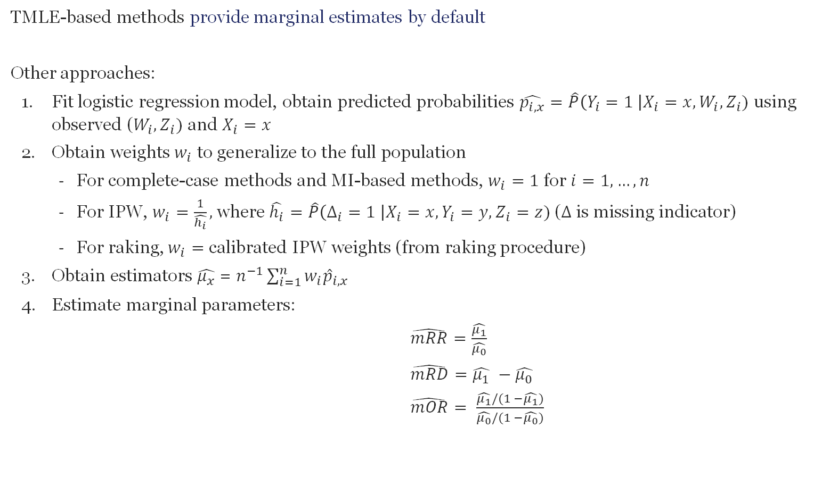
Estimating Marginal Estimands
TMLE-based methods provide marginal estimates by default
Other approaches:
  Fit logistic regression model, obtain predicted probabilities $\hat{p_{i,x}}=\hat{P}\left(Y_{i}=1 \right|X_{i}=x, W_{i}, Z_{i})$ using observed ($W_{i}, Z_{i})$ and $X_{i}=x$
  Obtain weights $w_{i}$ to generalize to the full population
    For complete-case methods and MI-based methods, $w_{i}=1$ for $i=1, …, n$
    For IPW, $w_{i}=\frac{1}{\hat{h_{i}}},$where $\hat{h_{i}}=\hat{P}\left(Δ_{i}=1 \right|X_{i}=x, Y_{i}=y, Z_{i}=z)$ ($Δ$ is missing indicator)
    For raking, $w_{i}=$ calibrated IPW weights (from raking procedure)
  Obtain estimators $\hat{μ_{x}}$ = $n^{−1}\sum_{i=1}^{n}{w_{i}{\hat{p}}_{i,x} }$
  Estimate marginal parameters:
  $\hat{mRR}=\frac{\hat{μ_{1}}}{\hat{μ_{0}}}$
  $\hat{mRD}=\hat{μ_{1}} −\hat{μ_{0}}$
  $\hat{mOR}= \frac{\hat{μ_{1}}/(1 −\hat{μ_{1}})}{\hat{μ_{0}}/(1 −\hat{μ_{0}})}$

